Slide 1
Data Snooping
FOLASHIKEMI MARYAM ASANI OLANIYAN
P2586104
MSc. Data Analytics

Slide 2
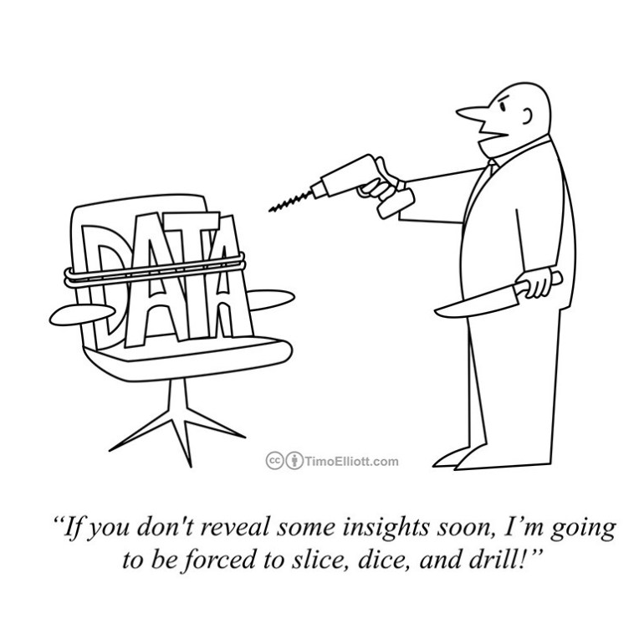
2
INTRODUCTION TO DATA SNOOPING.
Data snooping sometimes also referred to as data dredging, p-fishing or data fishing, is used to describe the situation in which a data set is analyses repeatedly without an a priori hypothesis of interest. The practice of data snooping, although common, is problematic because it can result in a significant finding (e.g., rejection of a null hypothesis) that is nothing more than a chance artefact of the repeated analyses of the data. The biases introduced by data snooping increase the more a data set is analyses in the hope of a significant finding. Empirical research that is based on experimentation and observation has the potential to be impacted by data snooping[1].
Data snooping is sometimes the result of the misuse of data-mining methods, such as the framing of specific alternative hypotheses in response to an observation arising out of data mining. [2]

Slide 3
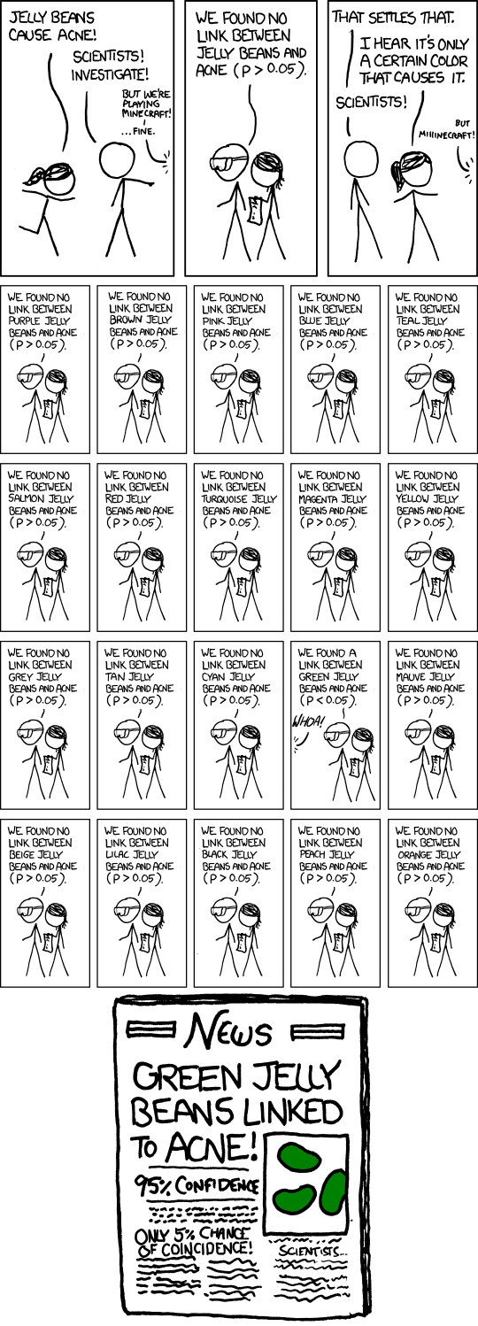
3
Data Snooping Humor
“ If you torture data long enough, I will confess to anything” – Ronald Coase
[3]
-https://imgs.xkcd.com/comics/significant.png

Slide 4
HOW DO SCIENTISTS DATA SNOOP
4
By performing multiple inferences on the same data set which create Type I, Type II Errors and Significance levels.
Type I Error
Rejecting the null hypothesis (p<=0.05) when it is true. Many scientists decide the p-value before doing the hypothesis testing.
The significance level α is the probability of making the wrong decision when the null hypothesis is true. this is one reason why it is important to report p-values when reporting results of hypothesis tests. It is also good practice to include confidence intervals corresponding to the hypothesis test.
Type II Error
Not rejecting the null hypothesis when in fact the alternate hypothesis (p-value > 0.05) is true is called α
Type II err
In practice, people often work with Type II error relative to a specific alternate hypothesis. In this situation, the probability of Type II error relative to the specific alternate hypothesis is often called β. In other words, β is the probability of making the wrong decision when the specific alternate hypothesis is true. [2]
Type III error
Wrong exclusion (probability level κ) – Probability of misidentification a non-outlying observation as an outlier, instead of the outlying one. This type of error decision was introduced.[3]
 |  | Truth (for the population studied)
 |  | Null Hypothesis True | Null Hypothesis False
Decision (based on a sample) | Reject Null Hypothesis | Type I Error | Correct Decision
 | Fail to reject the Null Hypothesis | Correct Decision | Type II Error
Fig 2. Summary of Type I and II Errors [5]

Slide 5
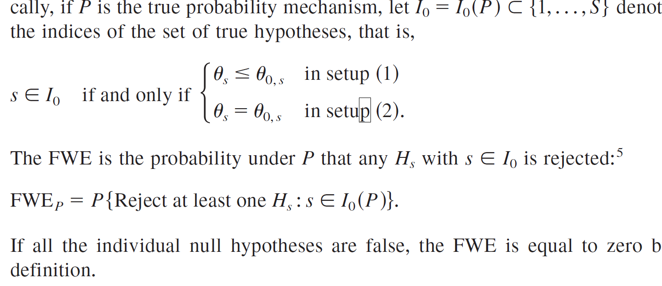
DEALING WITH MULTIPLE INFERENCE ON SAME DATA SET
5
Family-wise Error Rate is needed to consider the Joint Type I Error. Suppose you are performing two hypothesis tests using the same data. Suppose that all model assumptions are satisfied and both null hypotheses are true.[4]
Fig 3 Equation for FWER [5]
Dealing with Multiple Inferences
Bonferroni method
False discovery rate
Multiple inference in regression

Slide 6
Example 1
An investigator obtains data to investigate the impact of treatment on the mean of a response variable of interest without a predefined view (alternative hypothesis) of the direction (positive or negative) of the possible effect of the treatment. Data snooping would occur in this situation if after analysing the data, the investigator observes that the treatment appears to have a negative effect on the response variable and then uses a one-sided alternative hypothesis corresponding to the treatment having a negative effect. In this situation, a two-sided alternative hypothesis, corresponding to the investigator's priori ignorance on the effect of the treatment, would be appropriate. Data snooping in this example results in the value for the hypothesis test being halved, resulting in a greater chance of assessing a significant effect of the treatment. To avoid problems of this nature, many journals require that two-sided alternatives be used for hypothesis tests.[1]
Example 2
A data set containing information on a response variable and six explanatory variables are analysed, without any a priori hypotheses of interest, by fitting each of the 64 multiple linear regression models obtained utilizing different combinations of the six explanatory variables, and then only statistically significant associations are reported. The effect of data snooping in this example would be more severe than in Example 1 because the data are being analyzed many more times (more hypothesis tests are performed), meaning that one would expect to see several significant associations simply due to chance.[1]
A
Case Study

Slide 7
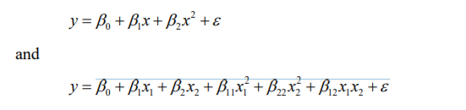


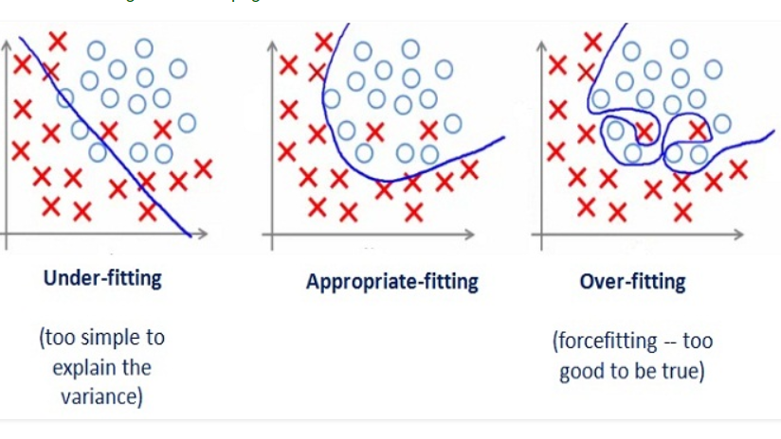
PROBLEMS AND CONSEQUENCES OF DATA SNOOPING
7
“Everything should be kept as simple as possible, but no simpler.”
-Occam's razor
Underfitting[6]
Fig . 4 Equation to solve underfitting
2. Overfitting occurs when a multiple comparison procedure is applied to model components.
Errors in adding components to a model, usually called overfitting, are probably the best
known pathology of induction algorithms. In empirical studies, induction algorithms often add spurious components to models. These components do not improve accuracy, and even reduce it, when models are tested on new data samples.[4]
Fig . 5 Elastic regularization – equation to correct overfitting
Fig . 6 Plots showing underfitting, good fitting and overfitting.

Slide 8
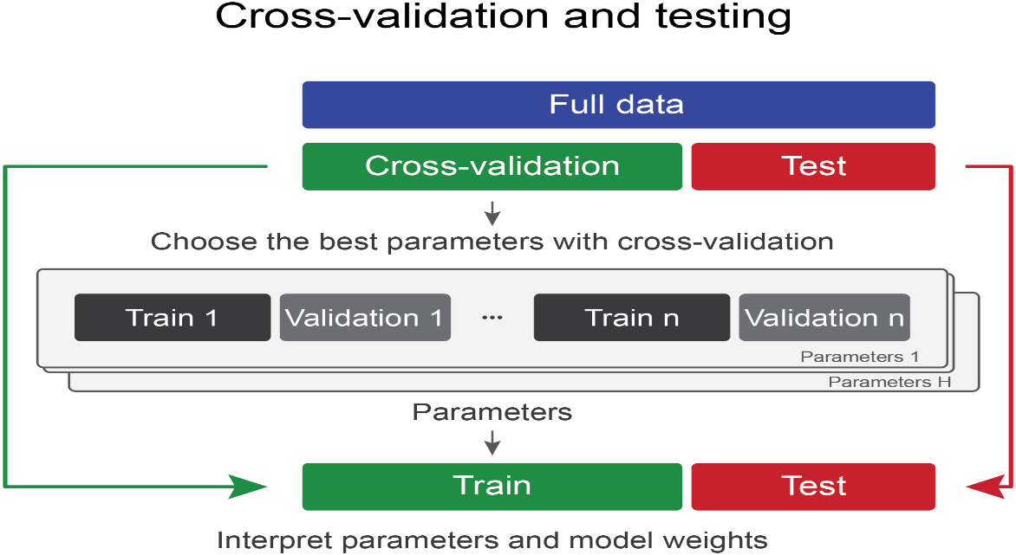
SOLUTIONS TO DATA SNOOPING
8
Protecting oneself against the problems of multiple inferences is the important information to remember
Avoid data snooping
Account for data snooping:
Researchers unintentionally obtain misleading results by data snooping is in failing to account for all of the data snooping they engage in. In particular, in accounting for Type I error when data snooping, you need to count not just the actual hypothesis tests performed, but also all comparisons looked at when deciding which post hoc (i.e., not pre-planned) hypothesis tests to try.[6]
New data and cross-validation:
A very common approach is to obtain new data or to divide an existing sample into two or more subsamples, using one subsample to select a small number of models and the other subsamples to obtain unbiased scores. Cross-validation is a related approach that can be used when the process for identifying a "best" model is algorithmic.[7]
Fig 7 Cross Validation and testing process.

Slide 9
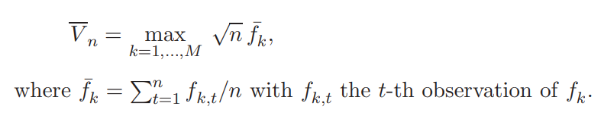

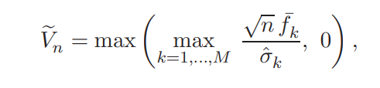
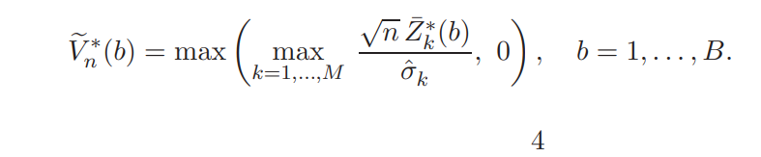
SOLUTIONS TO DATA SNOOPING
9
Resampling and randomization techniques:
Many of the most successful approaches are based on computationally-intensive techniques such as randomization and resampling using Monte Carlo Simulation.
White’s bootstrap approach is based on resampling. Similarly, randomization tests have been employed in several knowledge discovery algorithms. [8]
Fig. 8 White’s Reality Check Equation
Hansen's Test of Superior Predictive Ability (SPA)
Fig. 9 Hansen’s Test of Superior Predictive Ability Equation

Slide 10
References
Salkind, N. J. (2010) Encyclopedia of Research Design. Thousand Oaks, Calif: SAGE Publications, Inc. Available at: http://search.ebscohost.com.proxy.library.dmu.ac.uk/login.aspx?direct=true&AuthType=ip,shib&db=e000xww&AN=474297&site=ehost-live
Common misteaks mistakes in using statistics: Spotting and Avoiding Them https://web.ma.utexas.edu/users/mks/statmistakes/datasnooping.html
Ronald H. Coase, Essays on Economics and Economists
David Jensen, 2000, Data Snooping, Dredging and Fishing:The Dark Side of Data Mining https://www.academia.edu/2788313/Data_snooping_dredging_and_fishing_the_dark_side_of_data_mining_a_SIGKDD99_panel_report
Vinicius Francisco et al, 2017 An Attempt to Analyse Baarda’s Iterative Data Snooping Procedure based on Monte Carlo Simulation
An Efficient Data Partitioning to Improve Classification Performance While Keeping Parameters Interpretable https://journals.plos.org/plosone/article?id=10.1371/journal.pone.0161788#pone-0161788-g008 google scholar
WHITE, H., 2000. A Reality Check for Data Snooping. Econometrica.
Re-Examining the Profitability of Technical Analysis with White’s Reality Check and Hansen’s SPA Test

